Slide 1
Hospital Patient Flow Analysis
PRESENTED BY
JAYADEEP PANDRANKI

Slide 2
Problem Statement Hospitals are face challenges with bed shortages, high patient volume, and inefficient discharge/admission flow, leading to delays and congestion.
Agenda
Understand patient flow with data
Track average stay and bed occupancy
Identify readmission trends

Slide 3
KPIs (Key Performance Indicators)
KPI | DESCRIPTION FORMULA
Average Length of Stay | AVG(DATEDIFF(discharge_date ,admission_date))
Bed Utilization Rate | Occupied Beds / Total Beds
Admission/Discharge Rate | COUNT(admissions/discharges) GROUP BY Day
Readmission Rate | COUNT(Readmissions) / Total Discharges

Slide 4
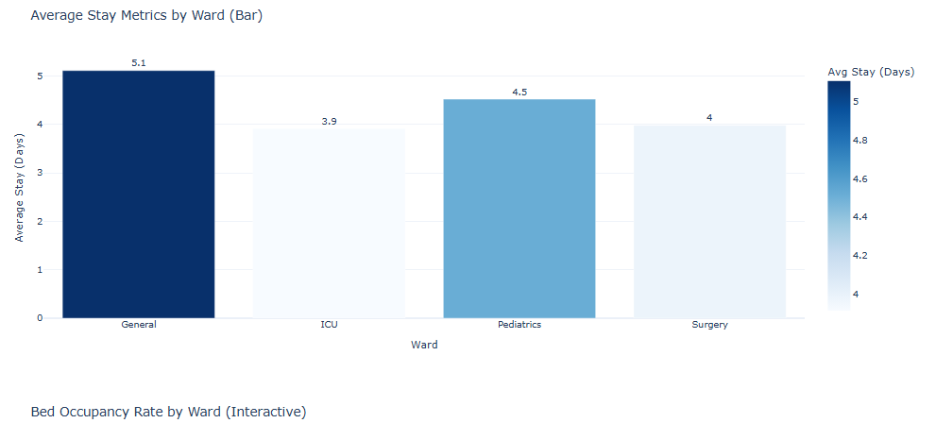
Graphical Representations
Average Length of Stay by Ward

Slide 5
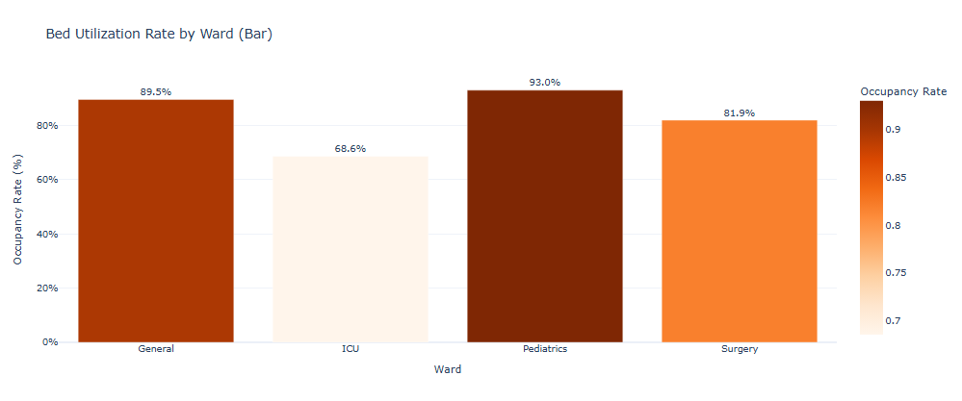
Bar Chart – Bed Occupancy Rate

Slide 6
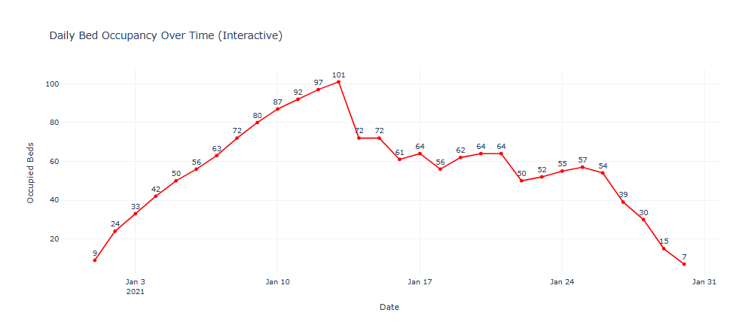
Line Chart – Daily Bed Occupancy

Slide 7
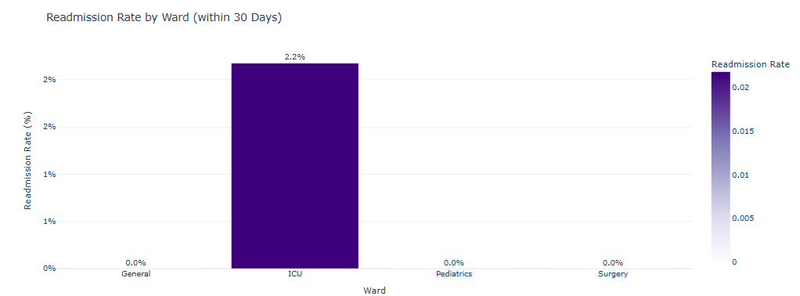
READMISSION RATE BY WARD

Slide 8
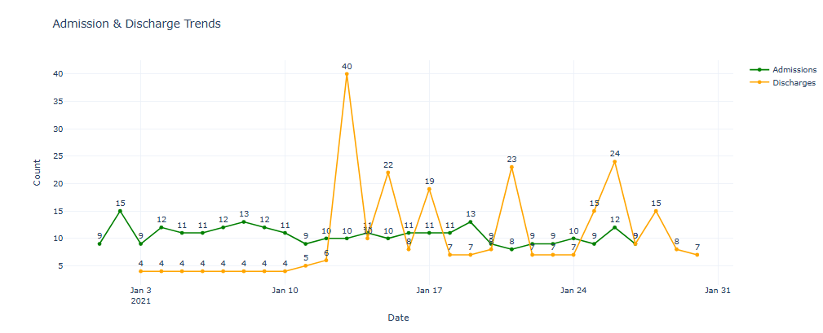
Admission/Discharge Trend

Slide 9
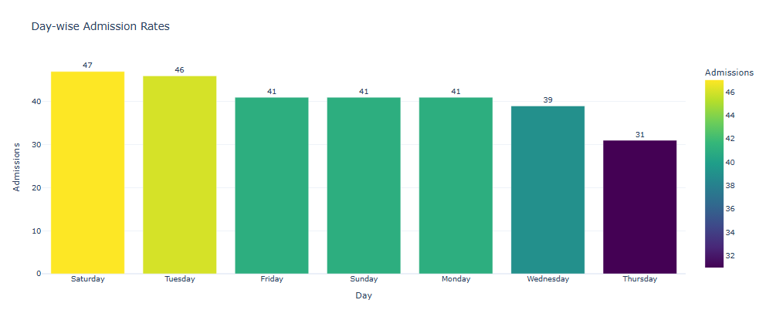
Day-wise Admission Rates

Slide 10
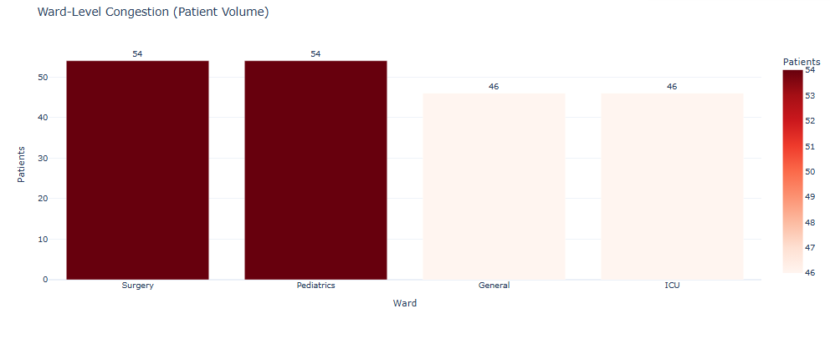
Ward-Level – Patient Count

Slide 11
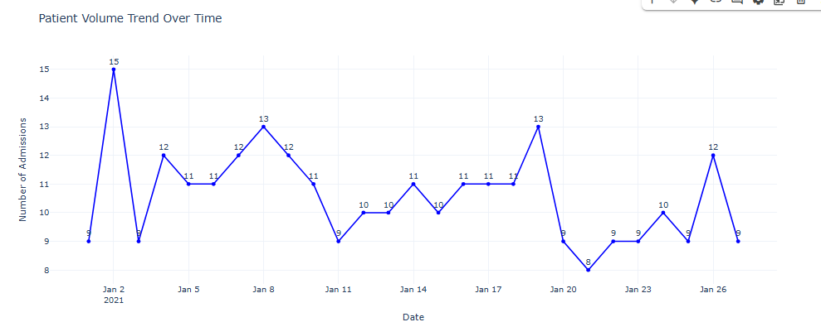
Patient Volume Trend

Slide 12
Insights
pediatrics and general wards have the highest bed utilization
Weekends average admissions, possibly due to scheduling gaps
Discharge volume peaks mid-weeks
Average stay is more in general ward

Slide 13
Recommendations
Improve discharge planning to reduce length of stay
Dynamic bed allocation based on occupancy trend
Add Flexible Beds in week days

Slide 14
THANK YOU

